Slide 1
Machine Learning
Linear Regression

Slide 2
Introduction
Most of the topics discussed in this lecture note will be essential in understanding, building, and training neural networks
We focus on training the linear regression model
  Closed-form equation that directly computes the model parameters that best fit to the training set
  Iterative optimization technique called Gradient Descent (GD) that gradually updates the model parameters
We then look at the Polynomial Regression to learn from non-linear datasets
Finally, we look at several regularization techniques that can reduce the risk of overfitting

Slide 3
Case study: univariate linear regression
A list of training instances
Model selection
𝒟 = {(x^{(i)}, y^{(i)})}
n i=1
h(x) = θ₀ + θ₁x
Parameters: θ₀, θ₁
Criterion: Choose these two parameters such that h(x^{(i)}) is close to y^{(i)} for our training dataset
Cost function or objective function:
1
n
J(θ₀, θ₁) =
_{∑ (h(x}(i)_{) − y}(i)₎
2
² i=1

Slide 4
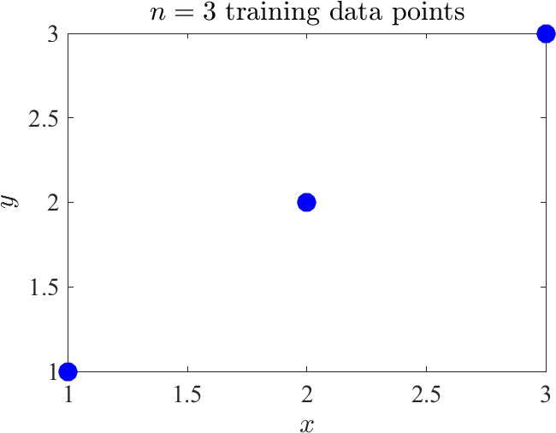
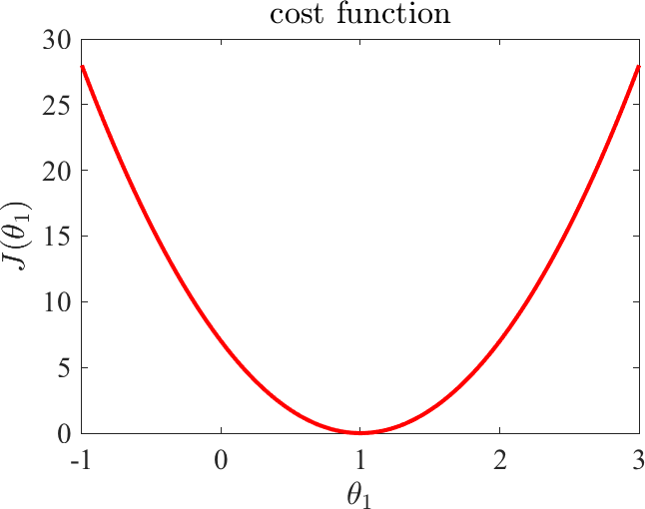
How to choose model parameters?
Let’s assume θ₀ = 0, which means that h(x) = θ₁x
Goal: Find the value of θ₁ that leads to the minimum value of J(θ₁)
Therefore, mathematical optimization is a central part of machine learning

Slide 5
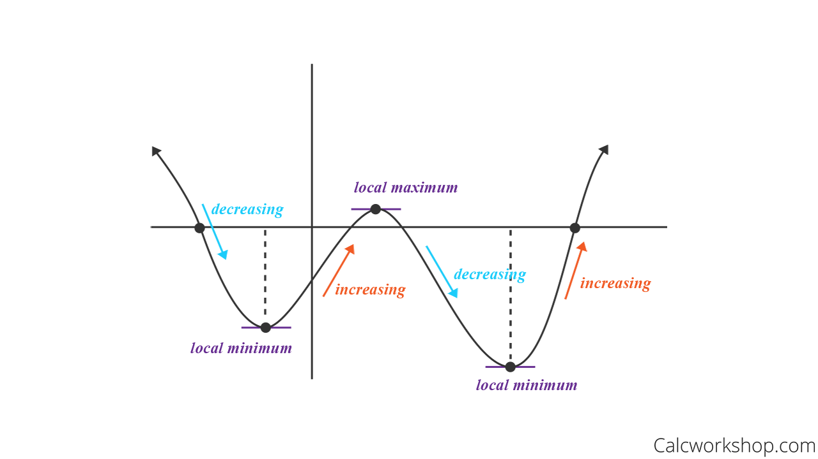
First derivative test

Slide 6
Gradient
Gradient captures all the partial derivatives of a multi-variable function
Example:
x₁
x = f(x) = x^{T} x = x² + x²
[x2]
1
2
∂f
∂x₁
= 2x₁
∂f
= 2x₂
∂x₂
∂f
∂x₁
2x₁
[2x₂]
∇f =
=
= 2x
∂f
∂x₂

Slide 7
Back to our previous example
Recall the univariate linear regression problem
1
n
J(θ₀, θ₁) =
(i)
(i)
2
(i)
(i)
(
h(x ) − y
)
, h(x ) = θ
+ θ x
∑
0
1
² i=1
Find partial derivatives

Slide 8
Back to our previous example
Recall the univariate linear regression problem
1
n
J(θ₀, θ₁) =
(i)
(i)
2
(i)
(i)
(
h(x ) − y
)
, h(x ) =
θ + θ x
∑
0
1
² i=1
Find partial derivatives
n
∂J
= _{∑ (}h(x ) − y ₎
i=1
n
(i) (i)
∂θ
0
∂J
= _{∑ (}h(x ) − y ₎x
i=1
(i) (i) (i)
∂θ
1

Slide 9
Multivariate Linear Regression
Assumption: parametric model where h(x) is a linear function of
d
h(x) = θ₀ + θ₁x₁ + θ₂x₂ + … + θ_{d} x_{d} = θ₀ + ∑ θ_{i}x_{i}
i=1
Tick: let x₀ = 1
d
h(x) = θ₀x₀ + θ₁x₁ + θ₂x₂ + … + θ_{d} x_{d} = ∑ θ_{i}x_{i} = ⟨x, θ⟩
i=0

Slide 10
Compact representation
Given the training set (x^{(i)}, y^{(i)}), i = 1,…, n, use dot products
h(x⁽¹⁾)
⋮
h(x^{(n)})
⟨x⁽¹⁾, θ⟩
⋮
⟨x^{(n)}, θ⟩
_{x}(1)
θ
=
=
…
[ _{x}(n) ]
= Xθ
Thus, we can rewrite the cost function
J(θ) = ¹ ∥Xθ − y∥²
2

Slide 11
A closed form solution
The partial derivatives are all zero at the minimum value
1
(2X^{T} Xθ − 2X^{T} y) = 0
2
X^{T} Xθ = X^{T} y
θ = (X^{T} X)⁻¹X^{T} y
This expression is known as the normal equation solution of the least squares problem

Slide 12
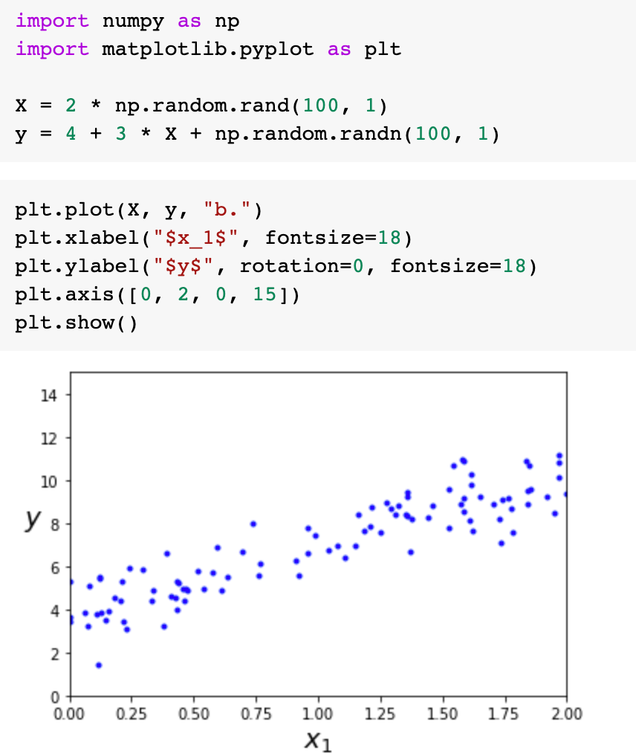
Linear regression using the Normal equation
Let’s generate some linear-looking data

Slide 13
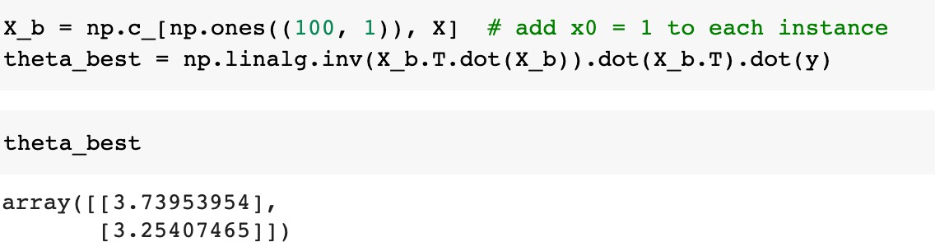
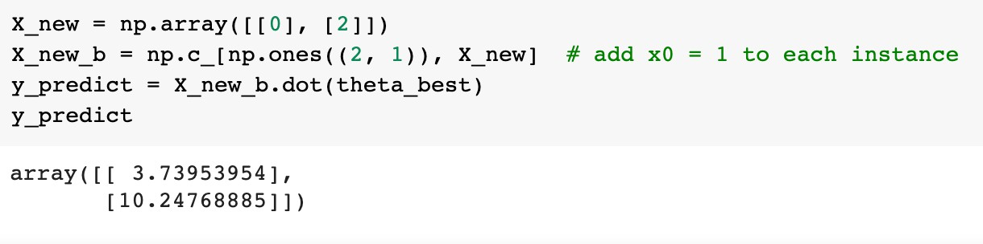
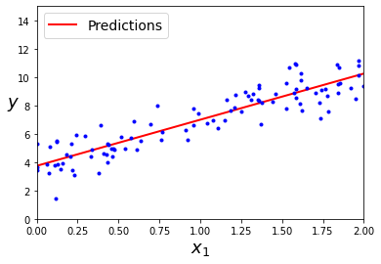
Linear regression using the Normal equation
Training
Let’s make predictions

Slide 14
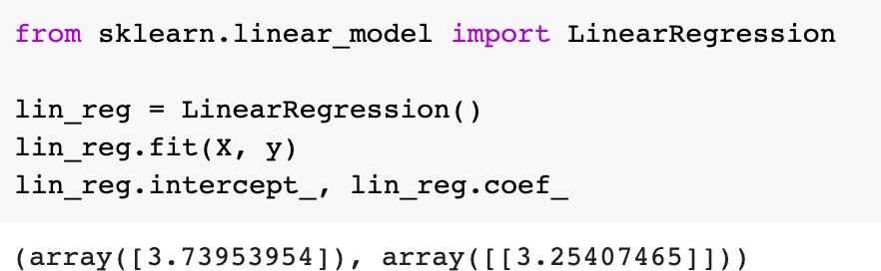
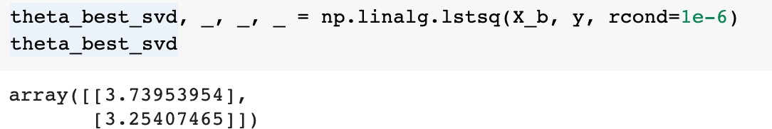
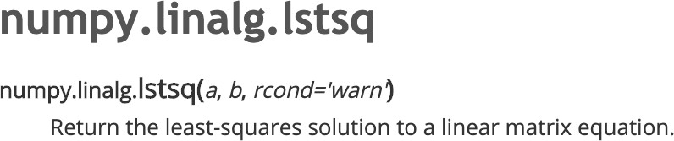
Linear regression using Scikit-Learn
How does LinearRegression from sklearn work?

Slide 15
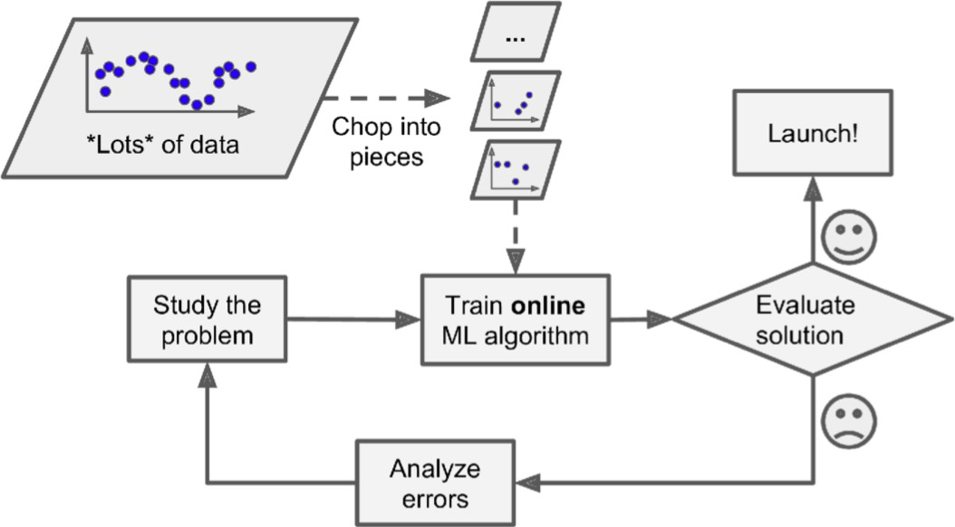
Computational complexity
When we have d features, we should compute an inverse of d × d matrix
  Double the number of features, you multiply the computation time by 2³ = 8
Too many training instances to fit in memory
Thus, we look at a different way to train a linear regression model

Slide 16
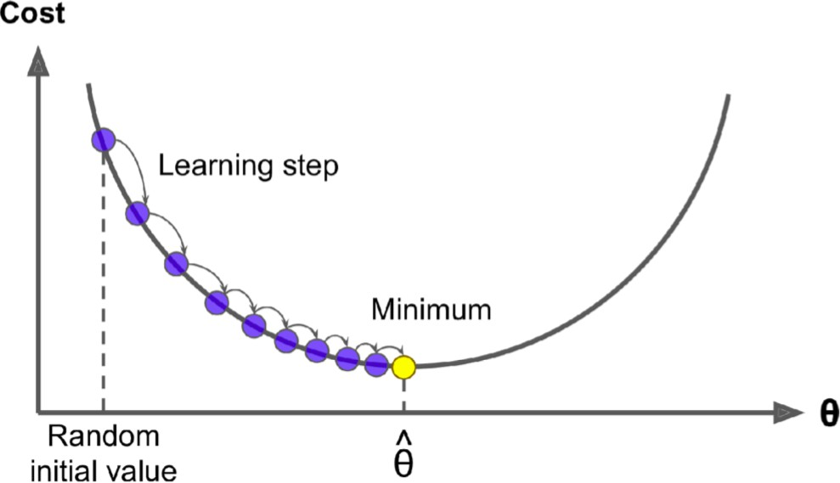
Gradient descent
Gradient Descent is a generic optimization algorithm capable of finding optimal solutions to a wide range of problems
Start by filling θ with random values
Take steps to decrease the cost function until convergence

Slide 17
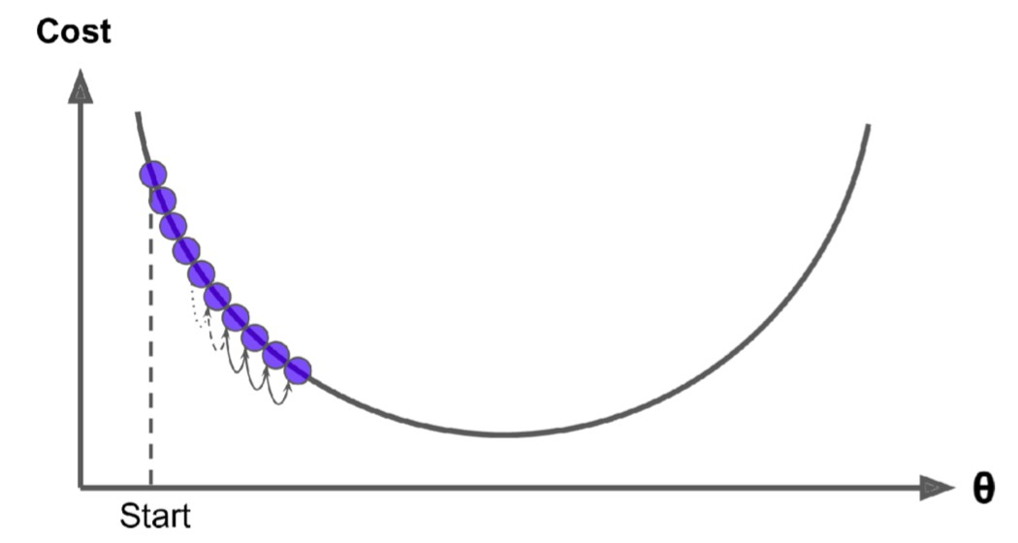
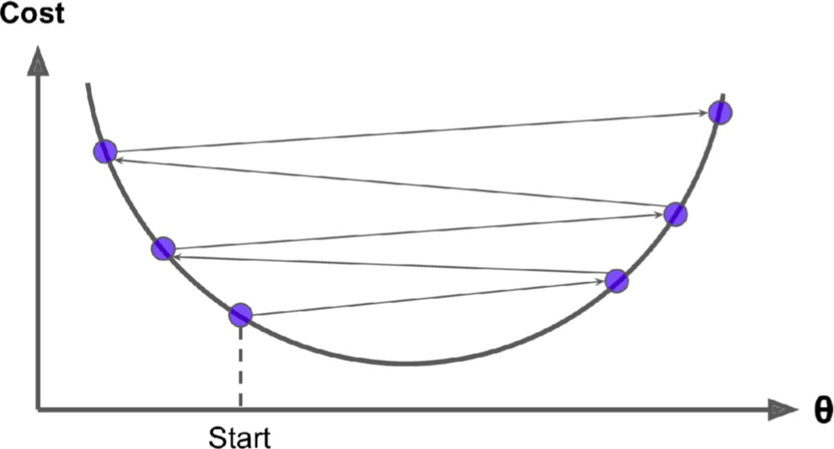
Hyperparameter
If the learning rate is too small: many iterations and take a long time
If the learning rate is too large: fail to find a good solution

Slide 18
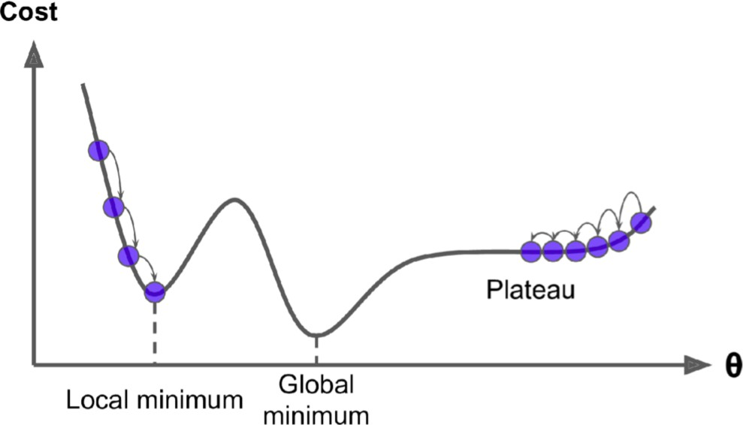
Challenges of using gradient descent

Slide 19
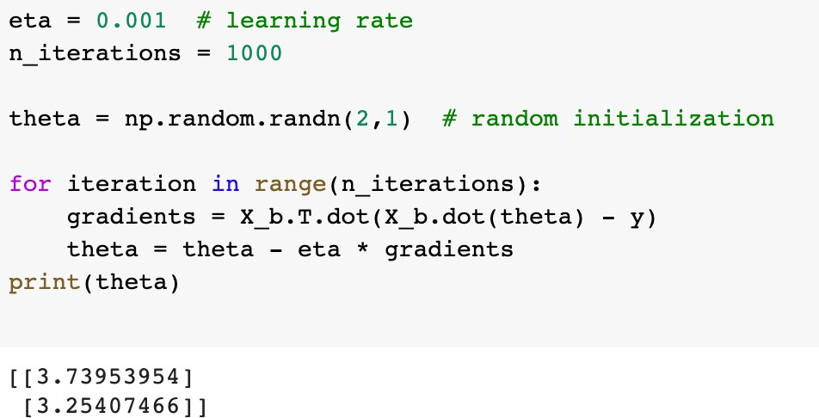
Gradient descent implementation
θ ← θ − η ∇J(θ)
This is known as Batch Gradient Descent

Slide 20
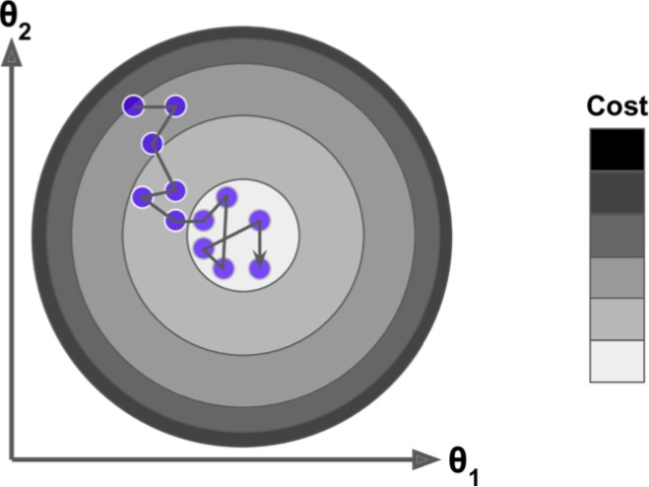
Stochastic gradient descent (SGD)
Stochastic gradient descent picks a random instance in the training set at every step and computes the gradient based on that single instance.
  Each training step is much faster but also much more stochastic (wiggly)
  Randomness can be good to escape from local minima

Slide 21
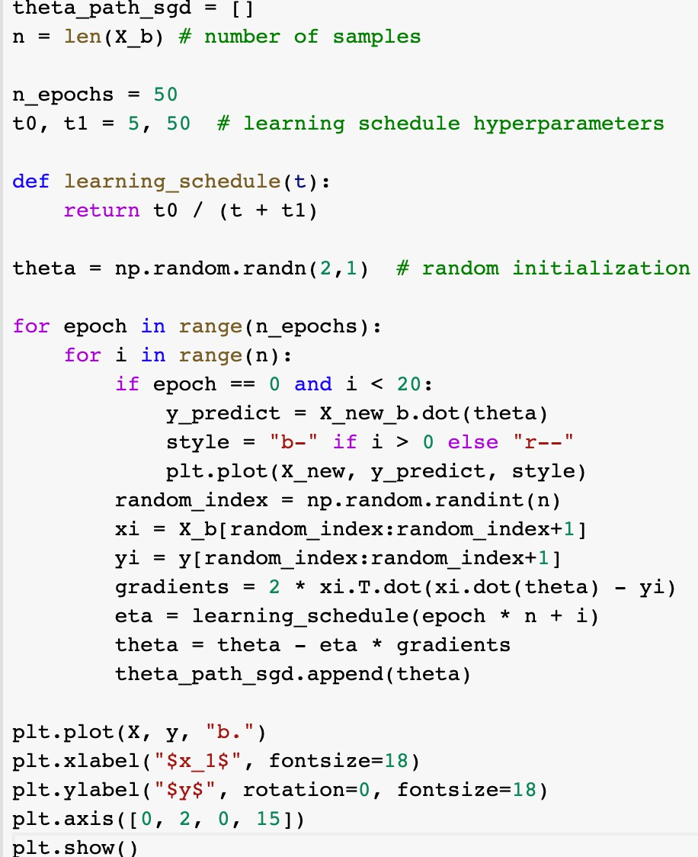
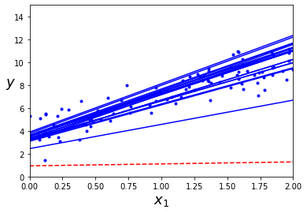
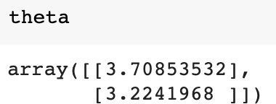
Implementation of stochastic gradient descent

Slide 22
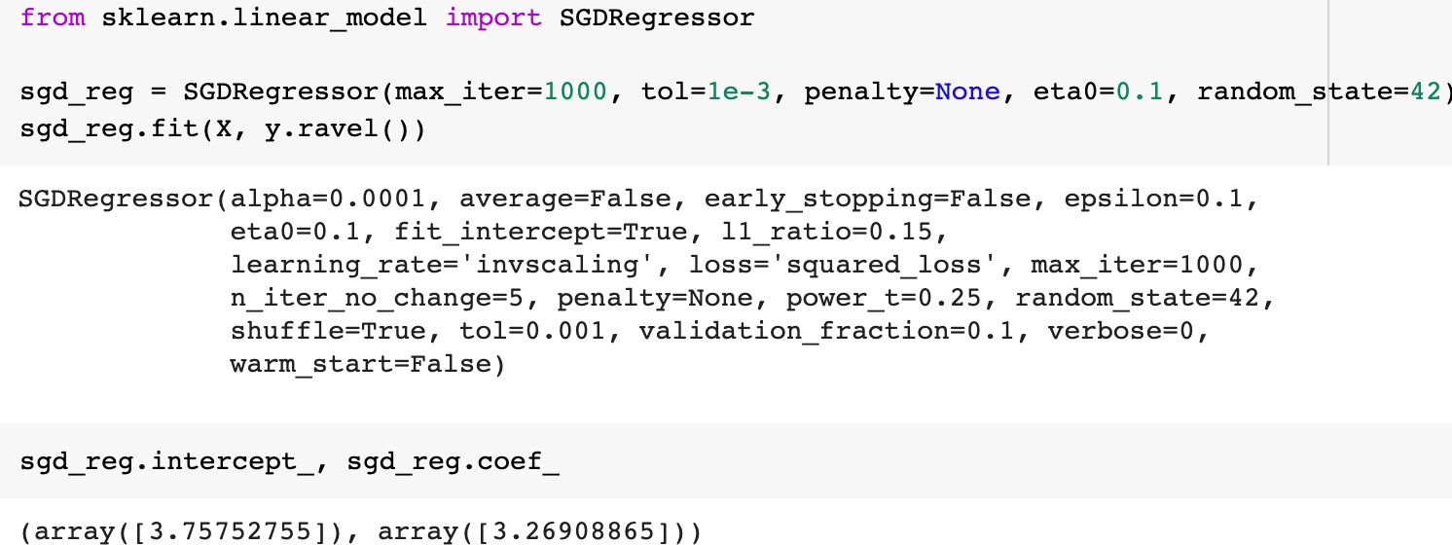
Linear regression using SGD

Slide 23
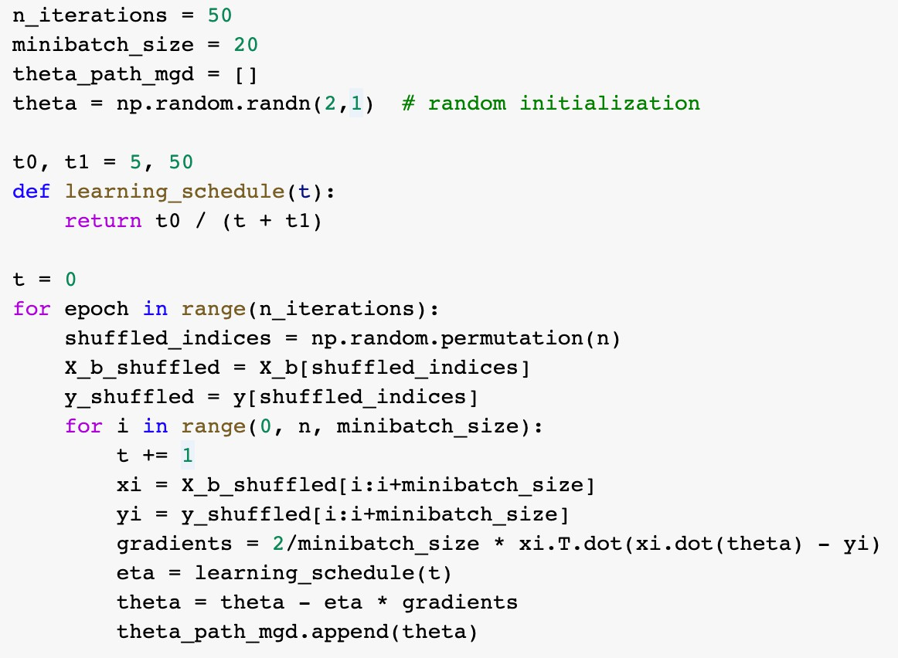
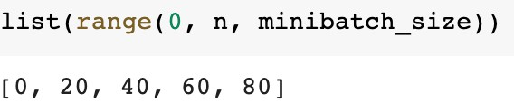
Mini-batch gradient descent
Computes the gradients on small random sets of instances called mini-batches

Slide 24
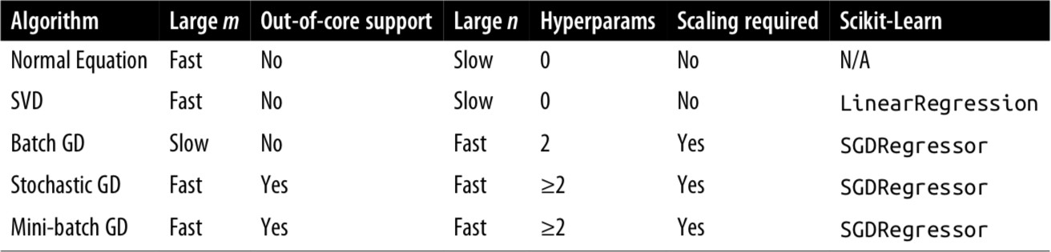
Comparison of linear regression implementations
Textbook notation: m (number of samples) and n (number of features)

Slide 25
Polynomial regression
A polynomial of degree 1 gives us the linear regression model
h(x) = θ₀ + θ₁x
Let us introduce x² as another feature
h(x) = θ₀ + θ₁x + θ₂x²
We can add more powers of as new features
h(x) = θ₀ + θ₁x + θ₂x² + θ₃x³
The output is a linear function of the parameters

Slide 26
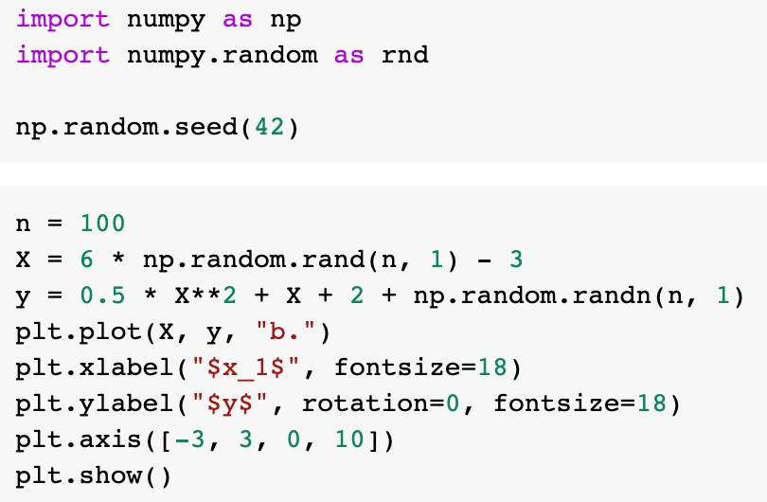
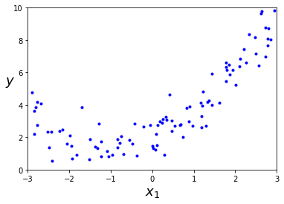
Polynomial regression

Slide 27
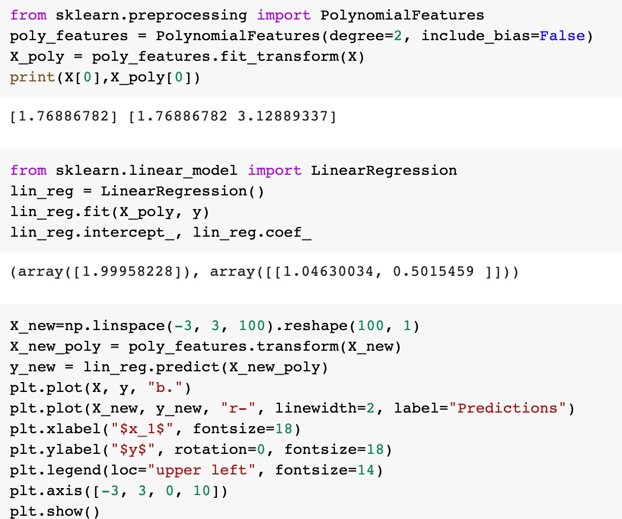
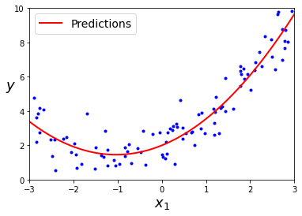
Polynomial regression

Slide 28
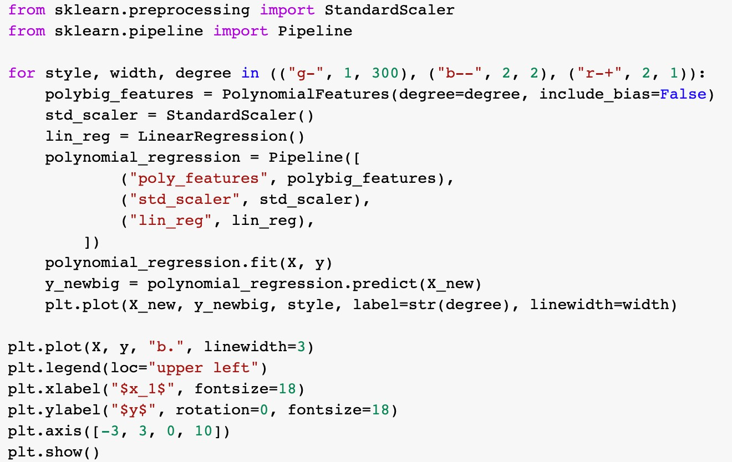
Selecting higher-degree polynomials

Slide 29
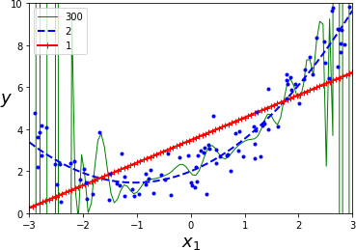
Selecting higher-degree polynomials
Observations:
  300-degree polynomial model wiggles around to get as close as possible to the training instances
  Overfitting: performs well on training data but generalizes poorly

Slide 30
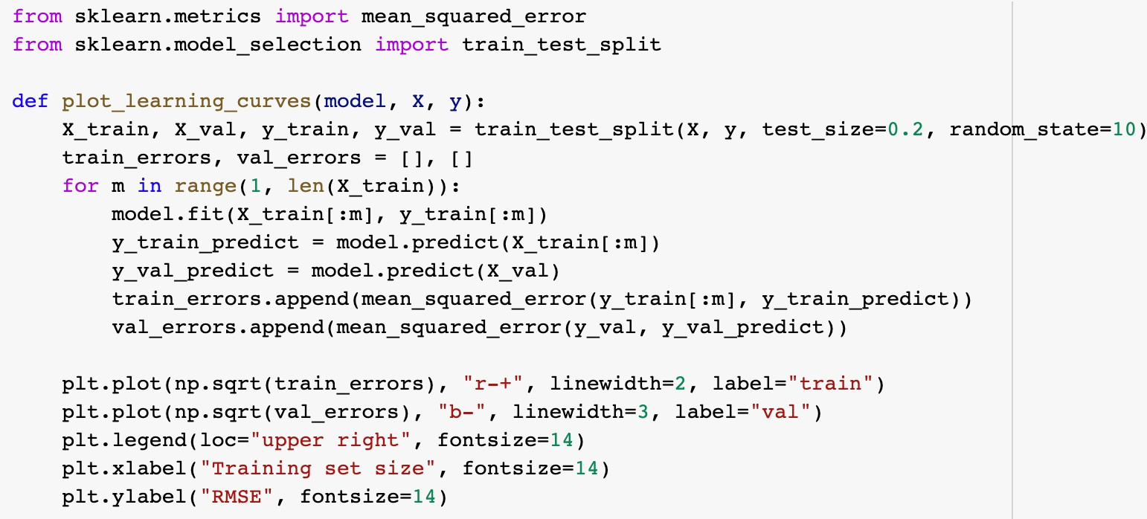
Learning curve
Plots of the model’s performance on the training set and the validation set as a function of the training set size

Slide 31
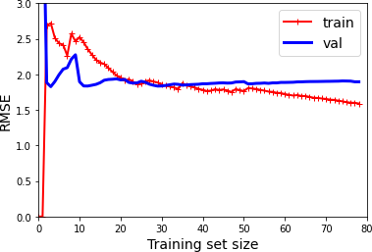
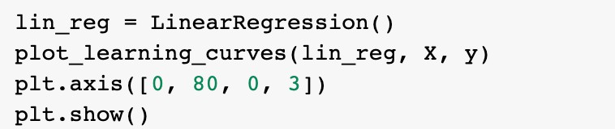
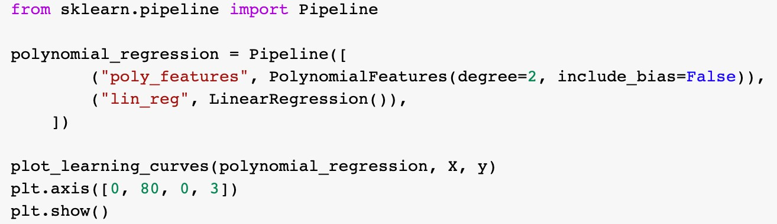
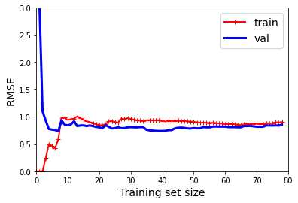
Learning curve
Linear regression
2-degree polynomial regression

Slide 32
Bias/variance tradeoff
Generalization error can be expressed as the sum of three different errors:
1. Bias: This is due to wrong assumptions, such as assuming the data is linear when it is actually quadratic
2. Variance: This is due to the model’s excessive sensitivity to small variations in the training data (i.e., degrees of freedom)
3. Irreducible error: This is due to the noisiness of the data

Slide 33
Regularized linear models
One way to reduce overfitting is to regularize linear models
For linear models, regularization is typically achieved by containing the weights of the model
d
h(x) = θ₀x₀ + θ₁x₁ + θ₂x₂ + … + θ_{d} x_{d} = ∑ θ_{i}x_{i} = ⟨x, θ⟩
i=0
  Keep the model weights as small as possible
Regularization is used only during the training process
We will look at
  Ridge regression
  Lasso regression

Slide 34
Ridge regression
We minimize the following loss function
∥Xθ − y∥² + α∥θ∥²
2 2
  α > 0 is hyperparameter
This problem has closed-form solution
θ = (X^{T} X + αI)⁻¹X^{T} y
  Or, we can use gradient descent

Slide 35
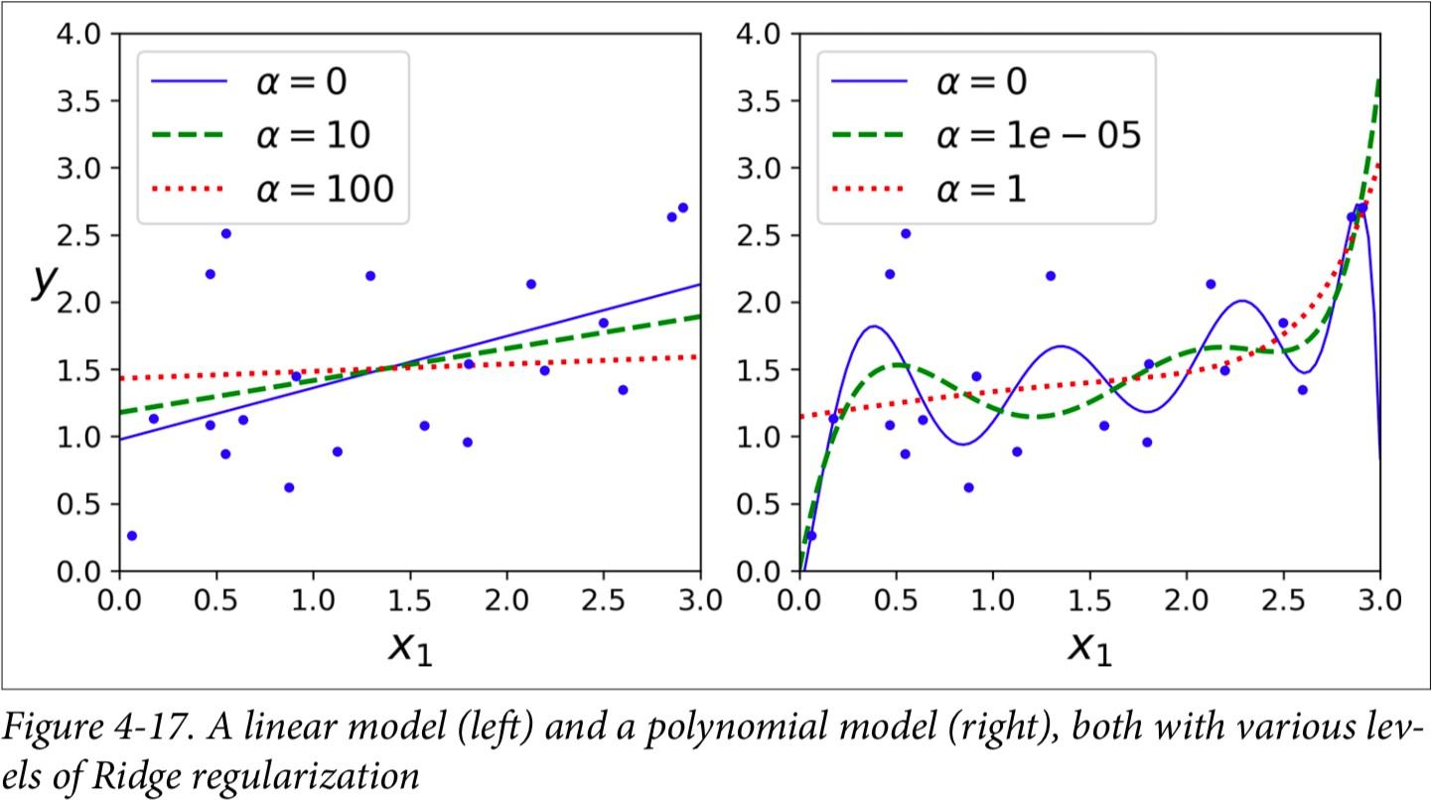
Ridge regression

Slide 36
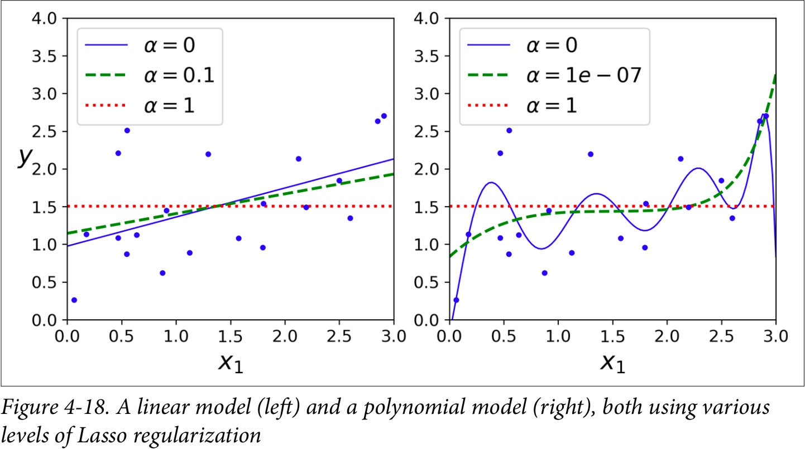
Lasso
We minimize the following loss function
1
2
∥Xθ − y∥ + α
| θ |
2n
∑
i
i

